Slide 1
Announcements
Weds. March 10th BISD Early Release Day
Spring Break March 15-19
Weds. March 24th from 9-1 PSAT for 9th and 10th Graders
PSAT Study Guides are available in the library
Weds. March 31 BISD Early Release Day

Slide 2
Adulting 101- Insurance
Insurance Common Terms
Deductible- the amount that you pay before your insurance kicks in. For car usually around $500-1000. Health insurance deductibles can range from
$500-2000 usually.
Claim- a formal request to your insurance company to help with repairs or other expenses.

Slide 3

Adulting 101- Insurance
There are 4 types of insurance for a college student/ young adult:
Health Insurance
Identity Theft Insurance
Auto Insurance
Renter’s Insurance

Slide 4
Adulting 101
Health Insurance-
The price for health insurance depends on your personal health needs.
Parents- You are able to stay on your parents’ health insurance plan until the age of 26.
University- If you are attending college, they will have an insurance option.
Job- Some jobs offer health insurance for their employees. This usually does not apply to part-time employees.
Self- You can also insurance yourself through the Affordable Care Act. Due to low income, this could be an affordable option.

Slide 5
Adulting 101
Health Insurance-
Catastrophe insurance has a much higher deductible, but can kick in when something really bad happens, such as a surgery or car accident, but doesn’t include dr. appts or medications.

Slide 6
Adulting 101
2. Identity Theft Insurance
Due to frequent online interaction, social media, etc., college students and young adults are highly susceptible to identity theft.
If someone steals your identity they can open credit cards in your name, take out loans, etc. This can affect your credit score and your ability to rent an apartment, get a car loan for years to come.
It can be very time consuming and expensive to fix this.
Identity theft is very affordable at about $10 a month,
such as LifeLock.

Slide 7
Adulting 101
3. Auto Insurance
It is against the law to drive without at least some auto insurance. There are three main types of auto insurance:
Comprehensive, Collision, and Liability

Slide 8
Adulting 101
3. Auto Insurance
Comprehensive pays for your car if is damaged by theft, vandalism, fire, hail, and damage from an animal (hitting a deer).
Collision pays for your car if it is damaged by a collision with another vehicle, collision with an object (hitting a fence), or single car accident.
Liability pays for the other driver’s car and medical injuries if you are at fault. Liability is the least inclusive and therefore cheapest. If you have a cheaper car, liability is probably enough. If you have a newer more expensive car, you may want all three.

Slide 9
Adulting 101
3. Auto Insurance
The cost of auto insurance depends on your age, where you live (Austin or Bastrop), what kind of car you have, and your driving history (any accidents or speeding tickets).

Slide 10
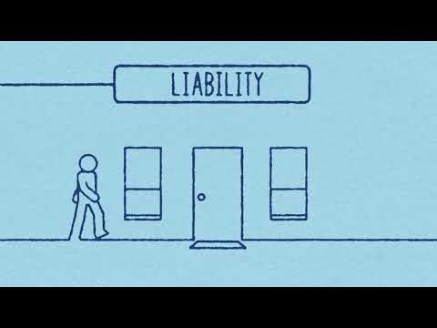
Adulting 101
4. Renter’s Insurance

Slide 11
Adulting 101
4. Renter’s Insurance
Renter’s insurance is very affordable, usually around $15-20 a month. It covers if your property gets stolen ie my bike.

